Slide 1
tackIT Improving Developer Productivity Since 2018

Slide 2

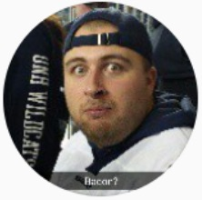
Who are we?
FreeMasons
Darren Anastasoff
Chris Figgins
Zach Rheaume

Slide 3

“Any fool can write code that a computer can understand. Good programmers write code that humans can understand.”
- Martin Fowler

Slide 4

1. What is tackIT?

Slide 5
Quick Starts
Here you have a list of items
And some text
But remember not to overload your slides with content
Your audience will listen to you or read the content, but won’t do both.

Slide 6
Collaboration
Here you have a list of items
And some text
But remember not to overload your slides with content
Your audience will listen to you or read the content, but won’t do both.

Slide 7
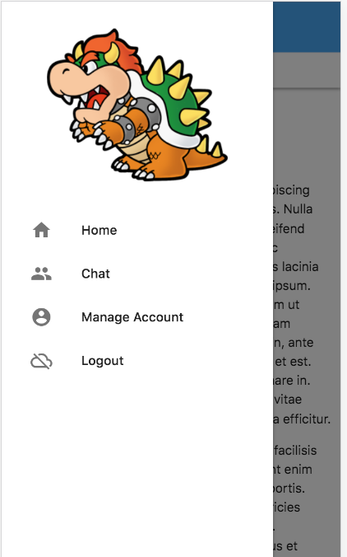
Mobile View
Place your screenshot here
Leveraging best in class technology to enable a world class mobile experience.

Slide 8
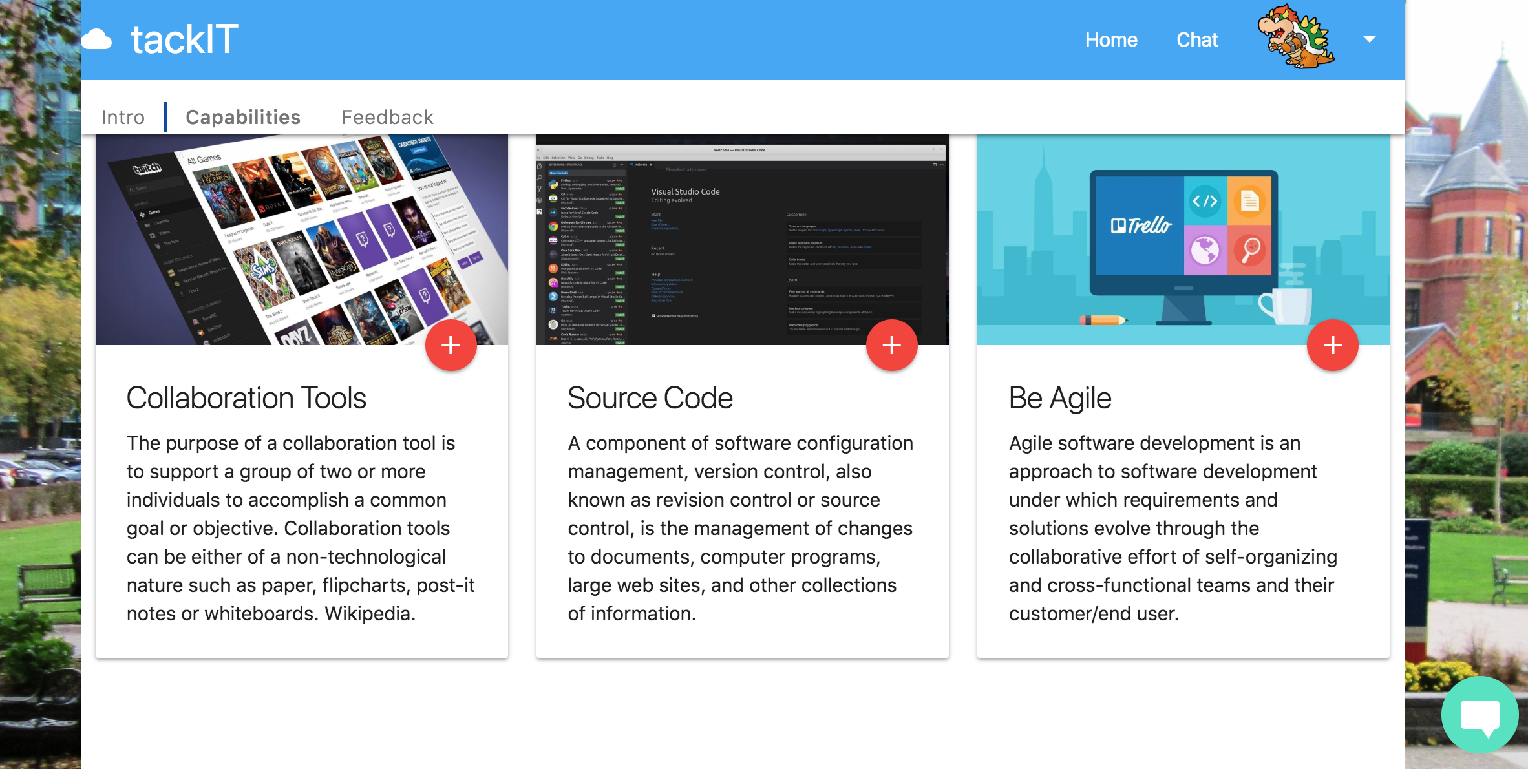
Desktop View
Although mobile is nice, developers leverage a laptop / desktop for real development – so we make sure to provide a smooth experience!
Place your screenshot here

Slide 9
Demo Time
Join us for a live demo at:
http://tackit.freemasonsnh.com

Slide 10
Focus on the business capabilities
While leveraging tackIT for the automation and collaboration tools

Slide 11
2. Project Config

Slide 12
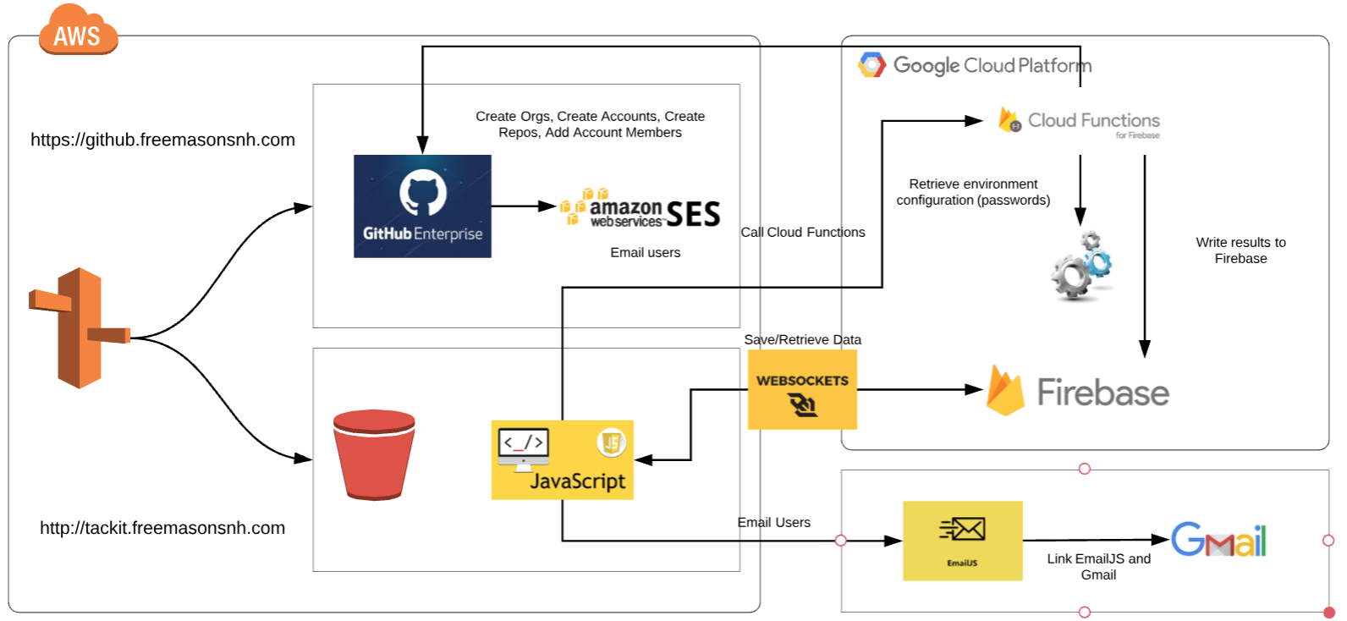
Architecture Diagram

Slide 13
Technology Leveraged
Cloud
AWS
S3
EC2
Route 53
Google Firebase Functions
Libraries
emailjs
cryptojs
materialize (JS & CSS)
momentjs
jquery

Slide 14
3. Teamwork

Slide 15
Work Breakdown
Horizontal
Vertical
Account
Chatbot
Chat
User Interface
JavaScript / API
Data Persistence
User Interface
JavaScript / API
Data Persistence

Slide 16
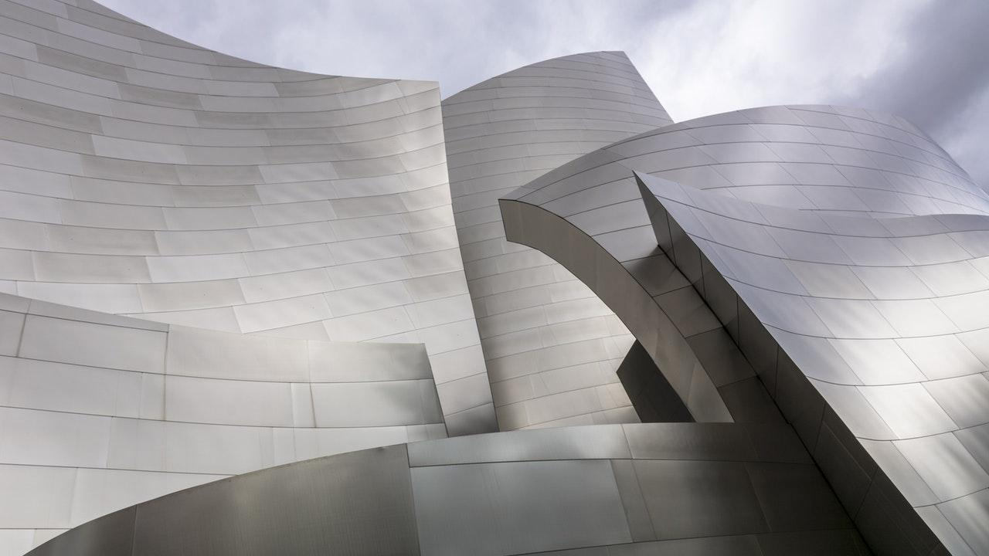
Individual Responsibilities
Darren Anastasoff
Responsible For:
Chatbot
Challenges:
Chris Figgins
Responsible For:
Account
Challenges:
Waiting on pull requests review
We all have full time jobs – different schedules
Zach Rheaume
Responsible For:
Chat
Challenges:

Slide 17
Improvement Opportunities
Real Security!
Limited by client side application
Additional Integrations:
Trello
Gitlab
Etc…

Slide 18
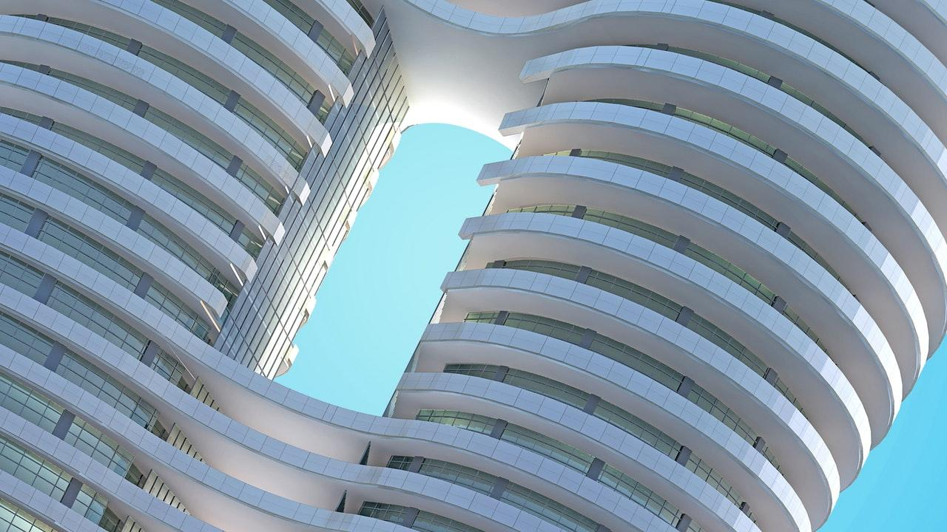
THANKS!
Any questions?
You can find us at:
tackit.freemasonsnh.com

